Slide 1



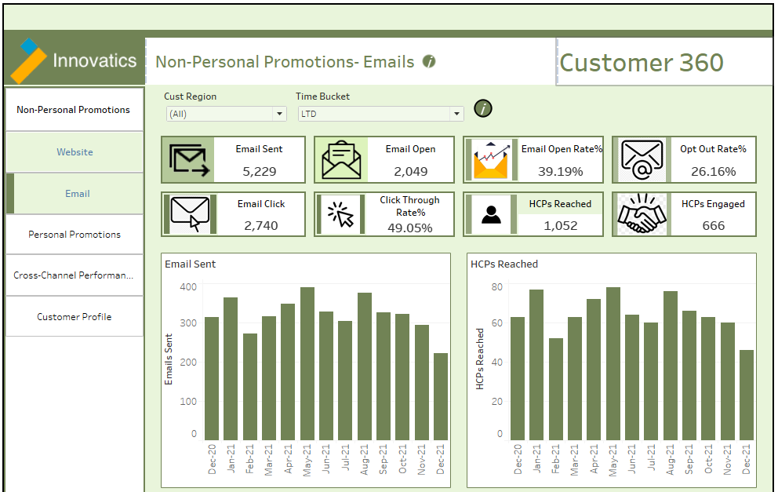
Customer 360 – Marketing Dashboard
Motive
Analytics Pipeline
Major Challenges
Since the company is launching a new product and Start promotion using different campaigns and website where data collecting from different resources and gather them together and use to compare and segregate on single platform for View and make business strategy and further promotional plans.
Our Solution
This performance tracking solution for each campaign Dashboard which will help track product performance on multiple hierarchical levels and different campaign on same level.
Gives the user a relatable information which campaign more effective and which need to carry-forward or need to change strategy.
Marketing Tools and Platforms
Data Transformation
Business Intelligence Tools
CRM platform is used to track visits completed by field employees.
Google Analytics is used to track Web marketing performance.
Data received from the different campaign which stored and used by Excel sheet here and SQL
Monthly refresh planned for both dashboards (Field and HQ).
Track geography, Segment and individual HCPs end .
Dashboard Sample and Use Case
Dashboard
Benefits
Different Campaign Performance Tracking and compare each campaign performance parallel.
Analysis at multiple granularities: Accounts, Segments, Geography.
Management can check Geography wise Budget Allocation.
Ad-Hoc Reports for daily tracking and actions.
This dashboard shows a portion of what information can be viewed by employees at the HQ.
The use case shown here is for the performance of the products across the different Geographies. CRM data is presented here to show KPIs like Email sent, Email Open, Email Click, Click through rate, open rate , Opt out rate, HCP reached by email , HCP engaged by email from field employees etc.
.All KPI track by Different Time bucket and check performance and comparison in time bucket
* Estimated

